Slide 1


Day 01
contact@anubhavtrainings.com
ABAP RESTFUL APPLICATION PROGRAMMING

Slide 2

Introduction

Slide 3


Agenda – Day 01
Introduction
Introduction to this course
Development Tools – Eclipse and ADT
Business Application Studio
VS Code
Difference between On-premise and Cloud
Type of offerings
What is BTP
Using Eclipse Development Tool for ABAP Development
Create DB Tables using Eclipse
Load Sample Data to the demo Tables

Slide 4
What to expect ?
Phase 1
Learn the basics of CDS to advance concepts and understand the RAP
Phase 2
Complete RAP development on S/4HANA with Fiori Apps using Annotations and Elements
Phase 3
S/4HANA Embedded Analytics
Phase 4
Node JS and SAP UI5 tooling with VS Code

Slide 5
Pre-requisite
1
Experience on S/4HANA
1
Understand the S/4HANA and how it is different from ECC
2
2
UI5 and Fiori Development
Aware of UI5 app development lifecycle
3
Strong Programming Skills
4
Good programming skills on ABAP
3
4
Knowledge of SAP
Have prior experience on one of the SAP Area

Slide 6

Features of ADT ( ABAP Development Tool )
01
Go to link
02
Install Java = java –version to check if its already there Java 8: SAP JVM 8 , Java 11: SapMachine 11
01
VS Runtime - For Windows OS: Microsoft Visual C++ 2013 (x64)
04
Get an installation of Eclipse 2021-06
(e.g. Eclipse IDE for Java Developers)
05
In Eclipse, choose in the menu bar Help > Install New Software...
06
Enter the URL
https://tools.hana.ondemand.com/latest
07
Select ABAP Development Tools and choose Next.
08
On the next wizard page, you get an overview
of the features to be installed. Choose Next.
09
Confirm the license agreements and
choose Finish to start the installation.
www.anubhavtrainings.com

Slide 7
Features of ADT ( ABAP Development Tool )
FREE and open source
Work with multiple systems parallelly
Fully customizable dev environment
It has integration with SAPGUI Ctrl+6
Fast Search and navigation
Ctrl+Shift+A – Search any object
Ctrl + T – Base classes
Integration with Transport Org, ATC
ABAP Profiles
This is the future of ABAP development on HANA and S/4HANA and even ABAP on Cloud
Verity of development using single tool – ABAP, UI5, HANA Native, Java, NodeJS, Android
Quick fix
Design time check on syntax
Code completion Ctrl+Space
Pretty Printer Ctrl+Shift+F
Code templates
Increases developer efficiency
ABAP has got new syntax, which means my old code is not dead and it will not work - False
www.anubhavtrainings.com

Slide 8
Development Tools BAS and VS Code
Step 1: Install your dev tool
BAS – SAP Businesss Application Studio
Local
VSCode – Free tool provided by Microsoft
It gives thousands of plugins which we can install to make life of a developer easy.
https://code.visualstudio.com/download
Step 2: Install Node JS
Download and install node js - https://nodejs.org/en/
Test if its available
node -v
www.anubhavtrainings.com

Slide 9
Compare
Business Application Studio VS Code
Tool provided by SAP Directly but a modified version of VS Code
Multi-cloud development tool for SAP specific developments
Runs in cloud, open browser and run
Cannot run w/o connectivity
Productive version is costly
Initial setup was very easy
If the SAP BTP is down, we cant use BAS
Your project is in cloud so you can easily switch device
Backup is already on cloud
All the fiori tooling is pre-installed in dev space
https://www.sap.com/products/business-technology-platform/price-list/estimator-tool.html
Tool provided by Microsoft provided by Microsoft which is an open source
We can use for different technological developments, but in local machine
Runs on local machine
Does not need internet connectivity
Free
Initial setup was little difficult for beginner
We can use anytime
We need to manually take project if we do device switch
It is developers job to take the backup
We need to configure in our laptop

Slide 10
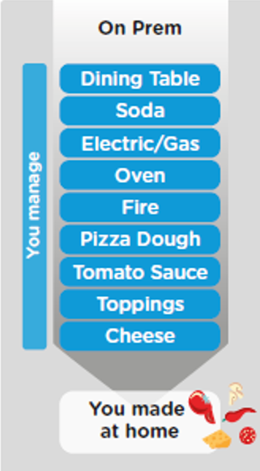
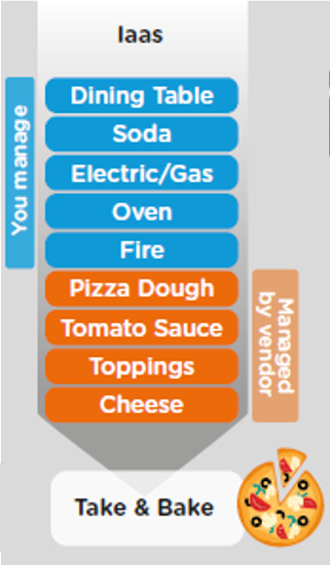
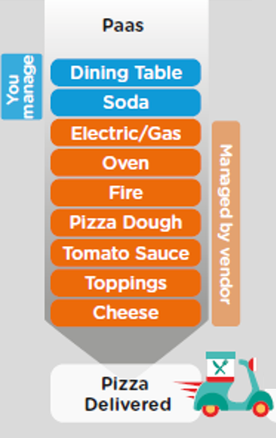
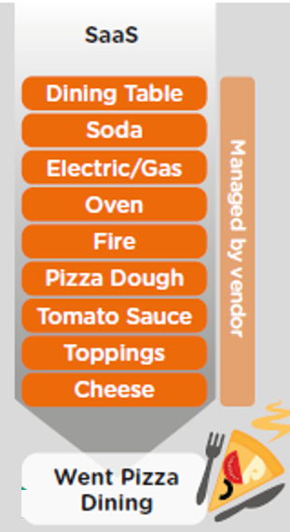
ON-PREMISE V/S CLOUD
www.anubhavtrainings.com

Slide 11
TYPE OF CLOUD OFFERINGS
Application
Application As a Service
Customer Managed
Customer Managed
Customer Managed
SAP Managed
Data
Runtime
Platform as a Service
SAP/Partner Managed
Middleware
Database
OS
Virtualization
Infrastructure as a Service
SAP/Partner Managed
Servers
Storage
Networking
www.anubhavtrainings.com

Slide 12
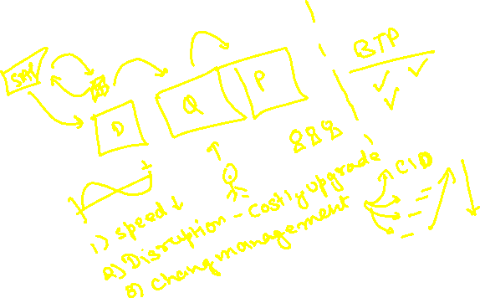
What is SAP BTP ?
SAP Business Technology Platform (SAP BTP) is the platform that powers you to become an intelligent enterprise through integration, extension, and data-to-value from all SAP and third-party application and data assets while ensuring your long-term success through agility, value-creation, and continual innovation.
BTP is an digital platform as a service to allow companies to build/integrate/extend existing solutions

Slide 13




WHAT IS SAP BTP?
Application
Application
Data
Data
Runtime
Platform as a Service
Managed by SAP implementing open source CF
Middleware
Fully ready landscape with reusable services
Scalability
Elasticity
Low TCO
Database
OS
Managed by Infrastructure
providers
Data Centers
Service Portfolio
Virtualization
Infrastructure as a Service
Servers
Storage
Networking
www.anubhavtrainings.com

Slide 14
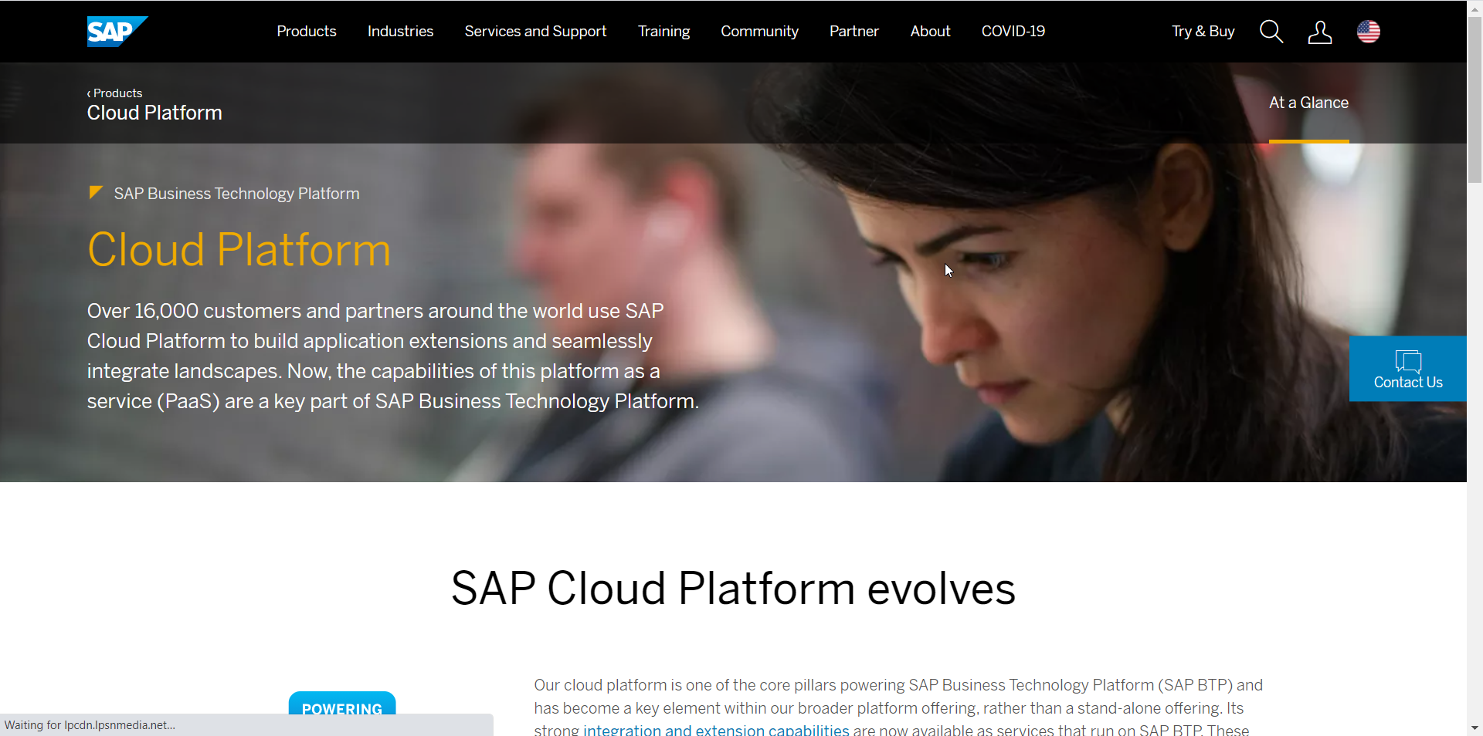
Setup Your FREE Account
https://account.hanatrial.ondemand.com/trial/#/home/trial
www.anubhavtrainings.com

Slide 15
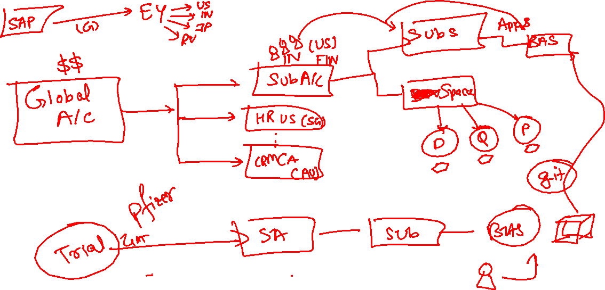

Slide 16
BAS
Dev Space
(VM) – 4GB
Dev Space
(VM) – 4GB
Dev Space
(VM) – 4GB
BTP (platform)
AWS – US East – 1000 GB

Slide 17
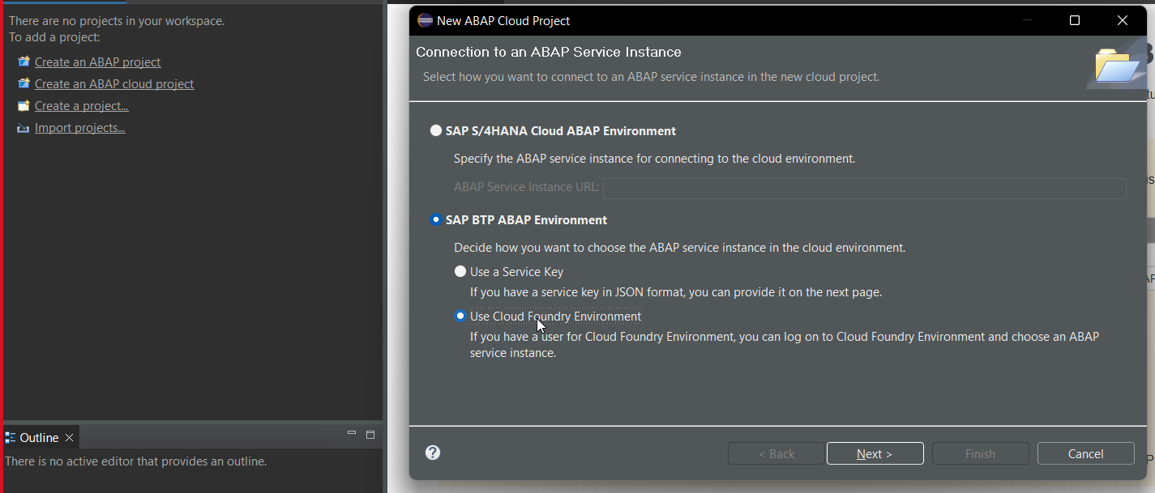
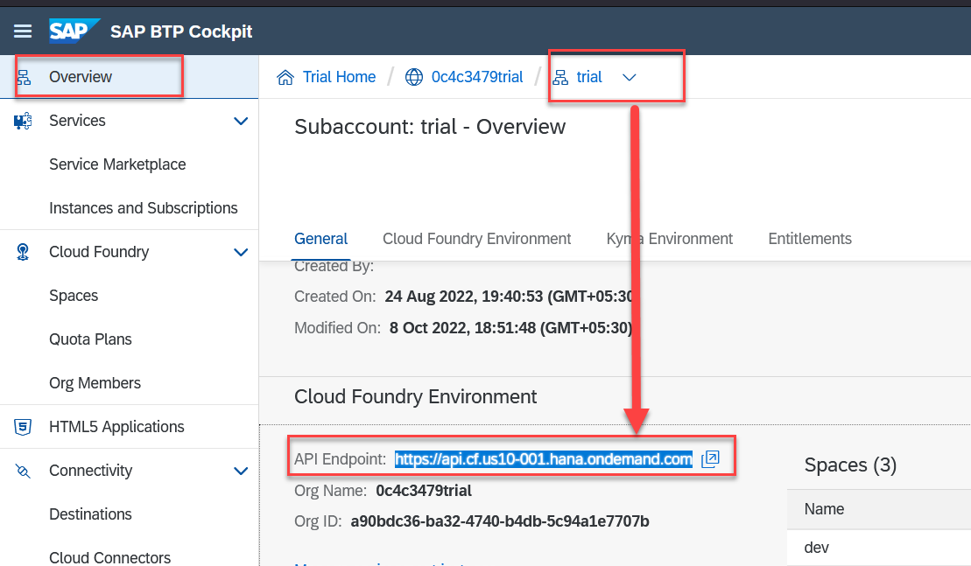

Slide 18
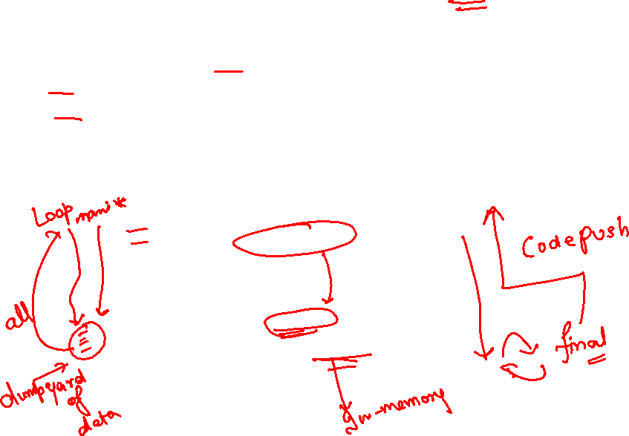
CDS – Core Data and Services
CDS is an extension of SQL in ABAP system. The main advantage of CDS is to achieve code-to-data paradigm. CDS is available for multiple purpose
DDL (data definition layer)
DQL (data query language) – CDS Views and CDS entities
DCL (data control language)
DEL (data expression language)
Fetch
Load
Loop
Process
Application
Fetch
Load
Loop
Process
Cds view
Database (HANA)
HANA view
www.anubhavtrainings.com

Slide 19
Create Your DB Tables
Business Partner
Sales Order Header
Sales Order Items
1..1
1..*
Product
1..1
Exercise
Create Data elements & Domain for ID (Char32) and Role (Char2)
Create Database Tables
Load Data to the table

Slide 20

End of Day 01
Trainer: Anubhav Oberoy

Slide 21

Trainer: Anubhav Oberoy

Slide 22
THANK YOU
If you cannot do
great things, do small things in a great way.
Anubhav Oberoy
https://www.anubhavtrainings.com

Slide 23


We’re committed to empower you to be
Most Desirable Resource
through powerful training solutions.
We build the workforce of the future.
250+
Corporate Clients
30,000+
Learners Trained
25000+
Learners Placed
FREE WEBINARS
Sign up for free webinars with industry experts every fortnight!
Enroll Now!
Contact us today!
https://anubhavtrainings.com/

Slide 24




More from AnubhavTrainings.com

